Slide 1

CRVS AND IDENTITY MANAGEMENT SYSTEM
OF THE REPUBLIC OF ARMENIA
KRISTINNE GRIGORYAN and Ani Mkhitaryan
MINISTRY OF JUSTICE OF THE REPUBLIC OF ARMENIA

Slide 2






e-Governance achievements in Armenia 2008-2017
Tax payer 3
eSignature and paperles workflow
eRegister
eStatements
ePolice
eAuctions

Slide 3






e-Governance achievements in Armenia 2008-2017
ePayments
eCadastre
eLicenses
On line budget
On line applications to the Government
DataLex and Arlis systems

Slide 4









e-Governance achievements in Armenia 2008-2017
  Electronic system of civil status registration
Electronic statistical statements
eConsulate
Official
E-mail for all citizens upon the birth
Electronic system of construction permits provision
eHealth
ID cards
Digitization of archives

Slide 5
THE ACTS OF CIVIL STATUS REGISTRATION
Birth
Acknowledgement of paternity
Adoption
Marriage
Divorce
Change of name
Death

Slide 6
Civil Status Acts Registration territorial Bodies
52 Civil Status Acts Registration territorial bodies (CSAR bodies).
Diplomatic corps of the Republic of Armenia abroad.

Slide 7
Transition to electronic management of CSAR
2012 : development and design of the electronic management system of CSAR
2013: Piloting electronic management system in CSAR bodies of Yerevan,
2013-2014 : Connection of electronic systems of social services, Police, National Statistical Service,
2014, September : full transition to CSAR electronic management system in all CSAR bodies.

Slide 8
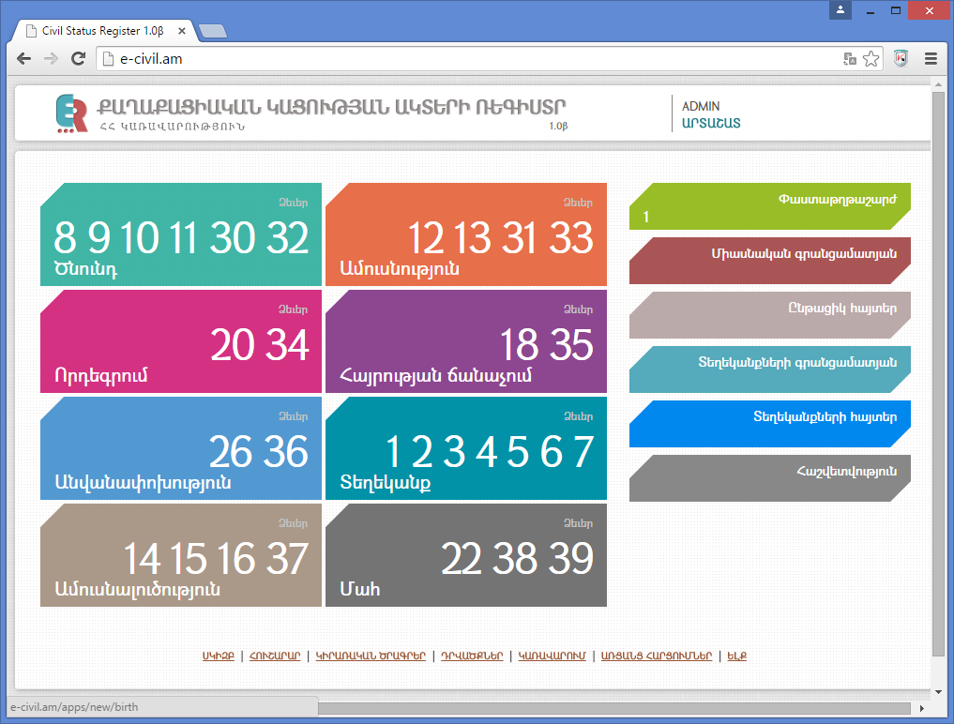
CSAR ELECTRONIC SYSTEM INTERFACE
Units of Electronic System
Birth Registration
Adoption Registration
Change of Name Registration
Divorce and Judicial Annulment of the Marriage Registration
Marriage Registration
Acknowledgement of Paternity Registration
References to Registrations
Death Registration

Slide 9
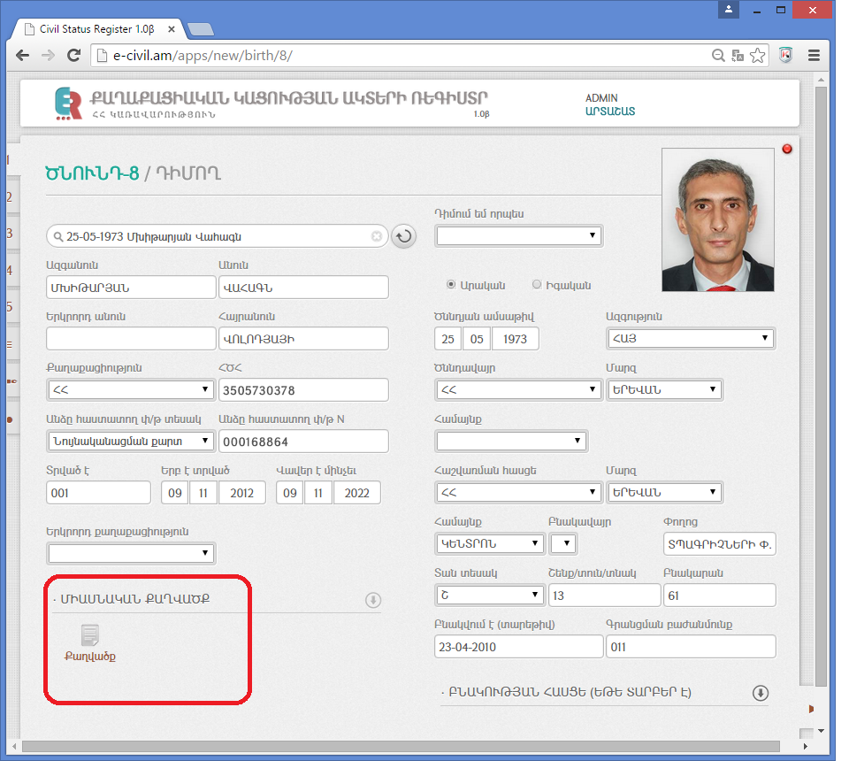
Interface of Personal information generation
An Identification of a person is generated by entering his name, surname and birth data, or ID number with name, surname of person in the certain line.
Automatic generation:
father’s name,
Date of Birth,
nationality,
citizenship status,
Identification number
abiding places,
ID cart number, date of issue and date of expiry and authority.
Photo

Slide 10
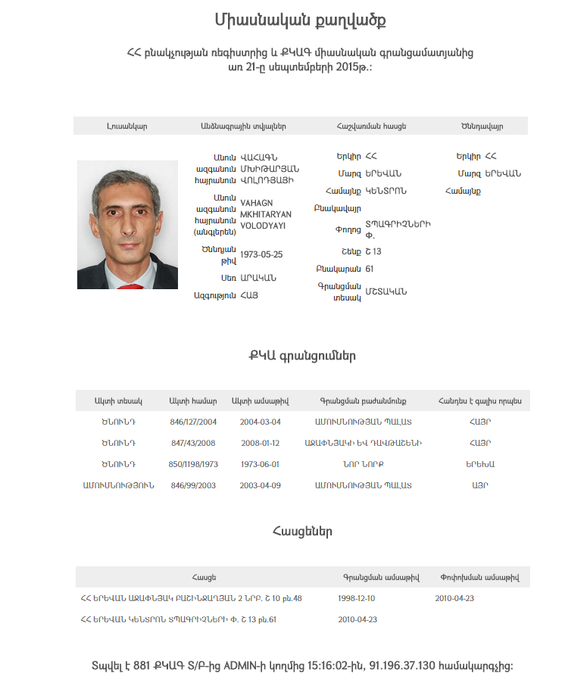
Civil Status Acts Registration Unified Registry for each person
    Personal data are used in the presentation by the permission of owner.
Electronic system identifies the persons, automatically collects unified registry of the SCR acts belonging to this person.
The birth registration of V.M. number of act, the place and date of registration
His Marriage registration: number of act, the place and date of registration, his status: husband.
2004 Registration of the son of V.M: number of act, the place and date of registration, his status: father.
2008 Registration of the son of V.M: number of act, the place and date of registration, his status: father.

Slide 11
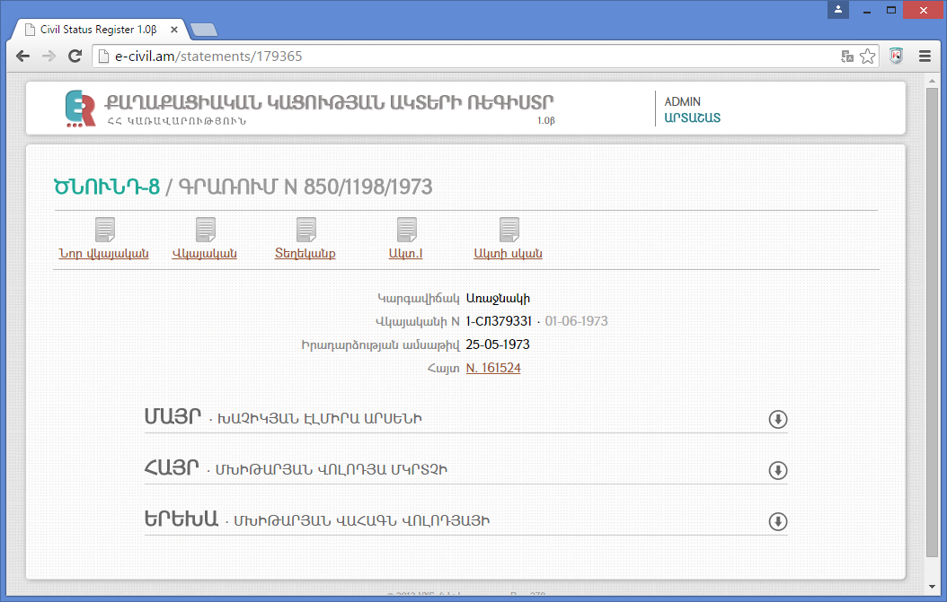
MAIN DUTIES OF NATIONAL REGISTRAR
Safekeeping of CSAR’s acts
CSAR act in the electronic register
For now:
All acts which are registered by the electronic system are saved on the optic carrier in the three different servers.
Acts are available for CSAR territorial bodies.

Slide 12
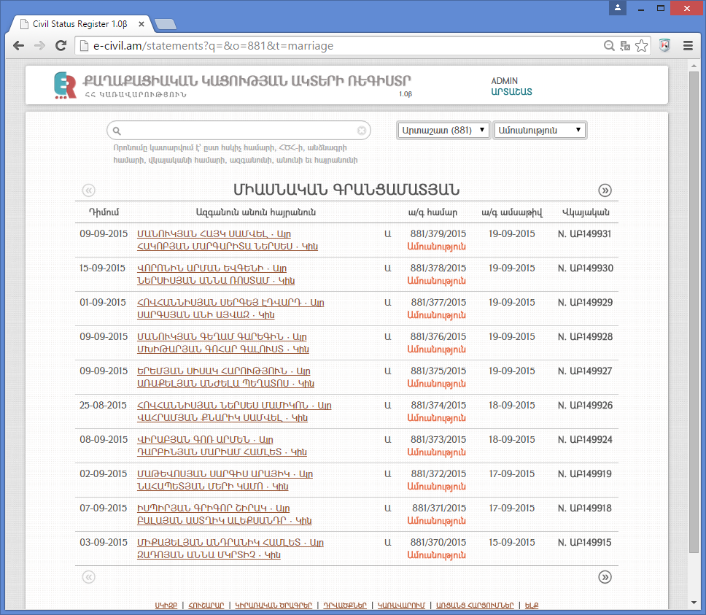
Civil Status Acts` Unified Register

Slide 13
OTHER DUTIES OF NATIONAL REGISTRAR
Safekeeping of CSAR acts on papers
The paper archive starts from 1924 года
Archive is comprises around 10.000.000 millions acts.
DIGITALIZATION of CSAR ACTs

Slide 14
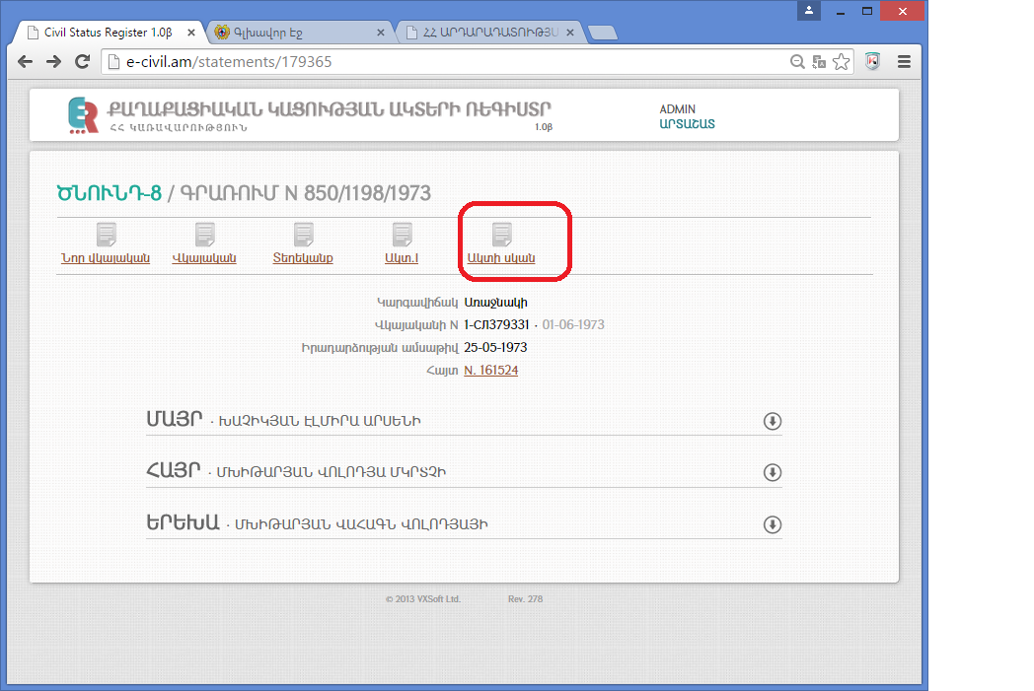
Digitalized Acts of CSAR
Personal data is entered by the employee,
All data is generated from the electronic system of Population State Register of Police,
Series and number of issued CSAR certificate are entered into the program
The scan of CSAR original Act are attached.

Slide 15
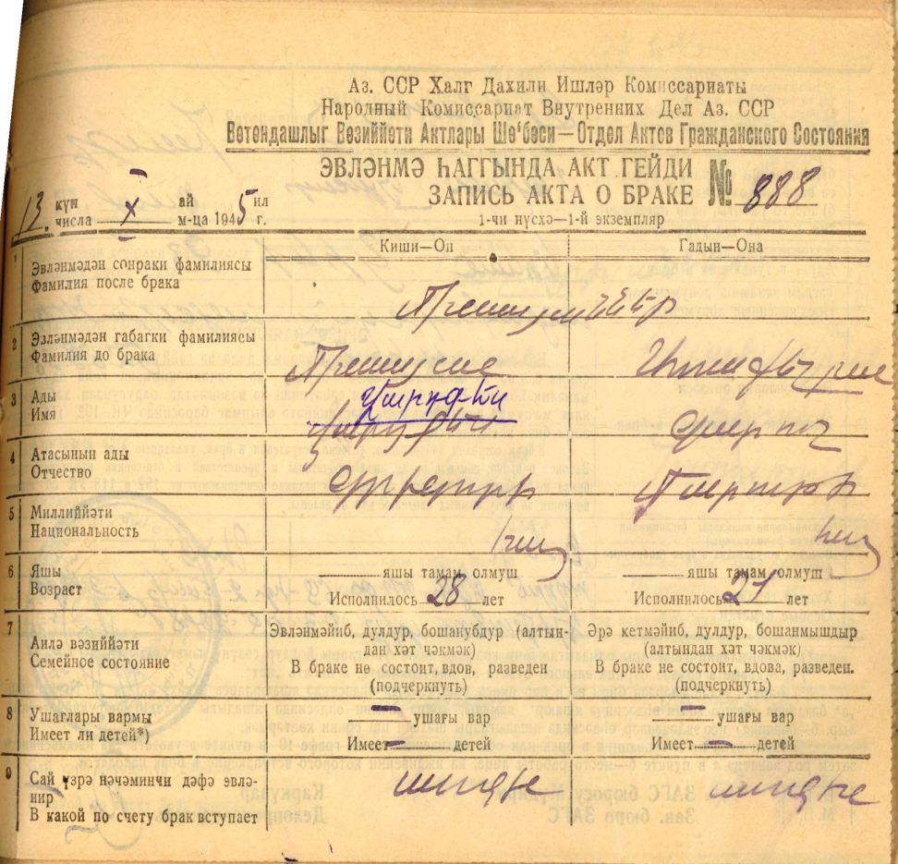
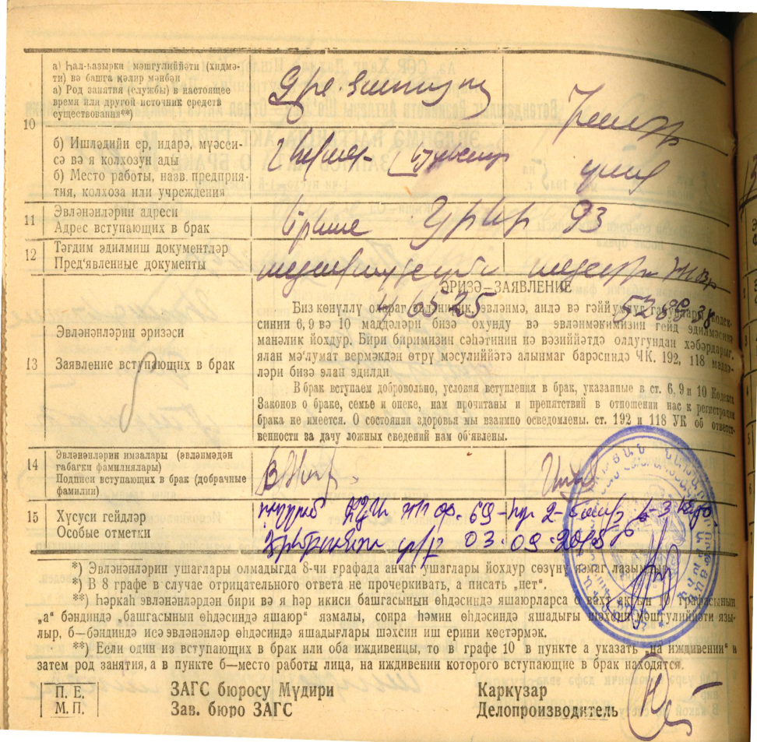
Scan of the CSAR Original Act

Slide 16
LINK TO NATIONAL STATISTICAL SERVICE
According to the law the acts of
Birth Registration
Death Registration
Marriage Registration
Divorce Registration acts
Are available for RA National Statistical Service day by day.
Territorial CSAR body
The National Statistic Service
The Republic Archive of RA Ministry of Justice

Slide 17
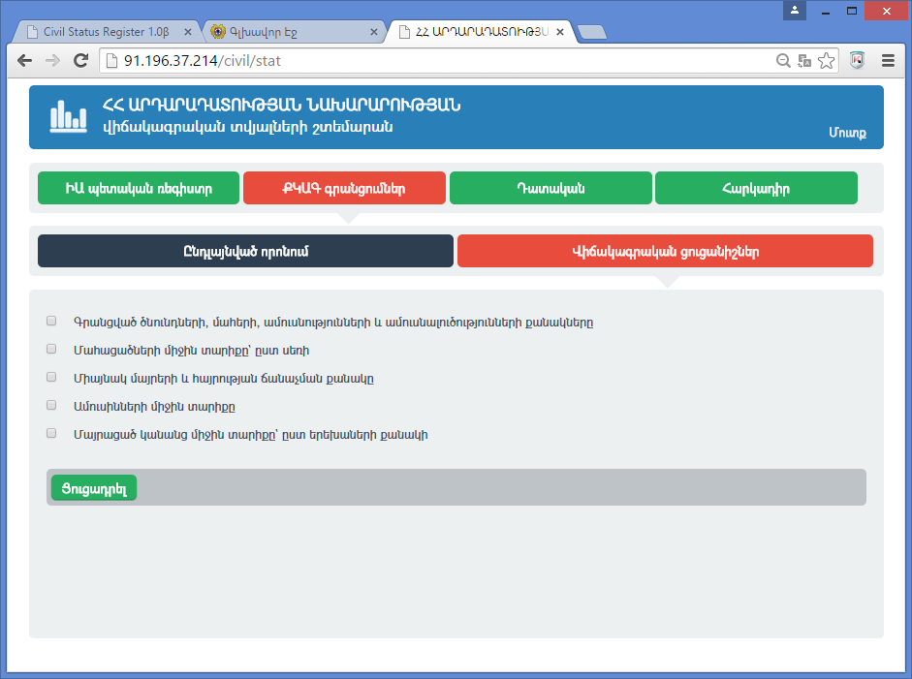
Statistical Data Unified Portal in the CSAR Electronic System
Statistical Indexes
Number of Birth, Death, Marriage and Divorce Registrations
Number of Single Mothers and registrations of acknowledgement of paternity
The average age of died
The average age of spouse
The average age of mothers, depending on the number of children.

Slide 18
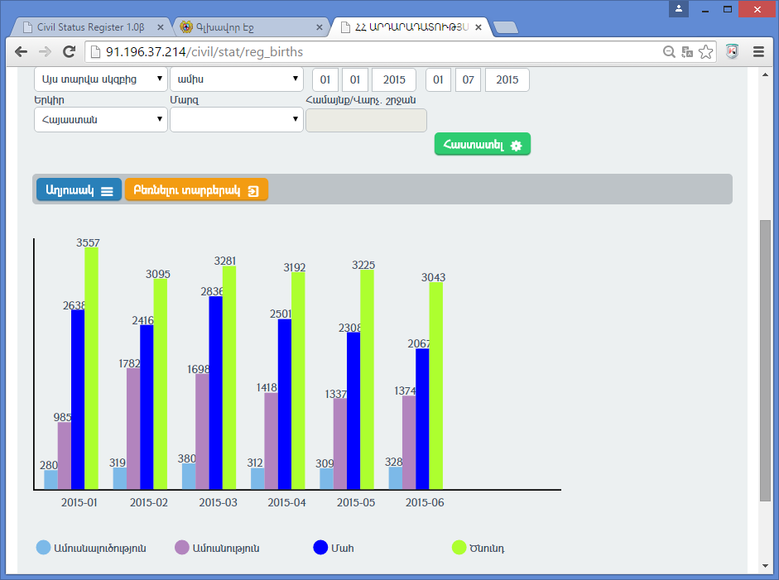
Statistical Data On-Line Publication
It is possible to see the statistical data on-line according the date, territories, the concrete regions.
Divorces
Marriages
Deaths
Births

Slide 19
CONNACTIONS NATIONAL REGISTRAR
The scheme of the CSAR acts transmission by electronic systems
The National Statistical Service of RA
Territorial CSAR bodies
Population State Register of Police of RA
CSAR Unified Register
E-HEALTH.AM
E-CONSULAR.AM
The Social Services of RA

Slide 20
THANK YOU !
You can follow the RA Government’s achievements on the official web-site: www.e-gov.am

